Slide 1
Telecom churn prediction
P.HARISH REDDY
Ch.BHANU PRAKASH
G.PRAVEEN KUMAR
B.JAGADISH

Slide 2
INTRODUCTION
Wireless companies today measure voluntary churn by a monthly figure, such as 1.9 percent or 2.1 percent.
Churn prediction is one of the most popular Big Data use cases in business. It consists of detecting customers who are likely to cancel a subscription to a service.
Churn is a problem for telecom companies because it is more expensive to acquire a new customer than to keep your existing one from leaving.

Slide 3
Project Objective
There are many ways: better products, better delivery methods, lower prices, building satisfactory customer relationships, better marketing and, above all, successful customer communications.
To predict Customer Churn.
Highlighting the main variables/factors influencing Customer Churn.
Use various ML algorithms to build prediction models, evaluate the accuracy and performance of these models.
Finding out the best model for our business case & providing executive summary.

Slide 4
DATASET DESCRIPTION
Source dataset is in csv format.
Dataset contains 7043 rows and 14 columns
There is no missing values for the provided
input dataset.
Churn is the variable which notifies whether
a particular customer is churned or not. And
we will be developing our models to predict
this variable only.

Slide 5
Churn prediction model
Training data
(5)Update
(!)Build
Model
Real
independent
(4)Predict
(2)Test
Testing data
(3)Test=Ok

Slide 6
Methodologies
EDA(Exploratory Data Analysis): The dataset consists of 12 variables in all. A few are continuous, rest are categorical. The control variable was customer.
Model building which includes defining the purpose if model, determine the model boundary, build the model, create an interface and export the model.
Evaluating machine learning algorithm is an essential part of project.

Slide 7
Exploratory Data Analysis
Data visualisation using seaborn and matplotlib
Exploratory data analysis (EDA) is an approach to analyse data sets & to summarize their main characteristics, often with visual methods.
A Statistical model can be used or not, but primarily EDA is for seeing what the data can tell us beyond the formal modelling or hypothesis.

Slide 8
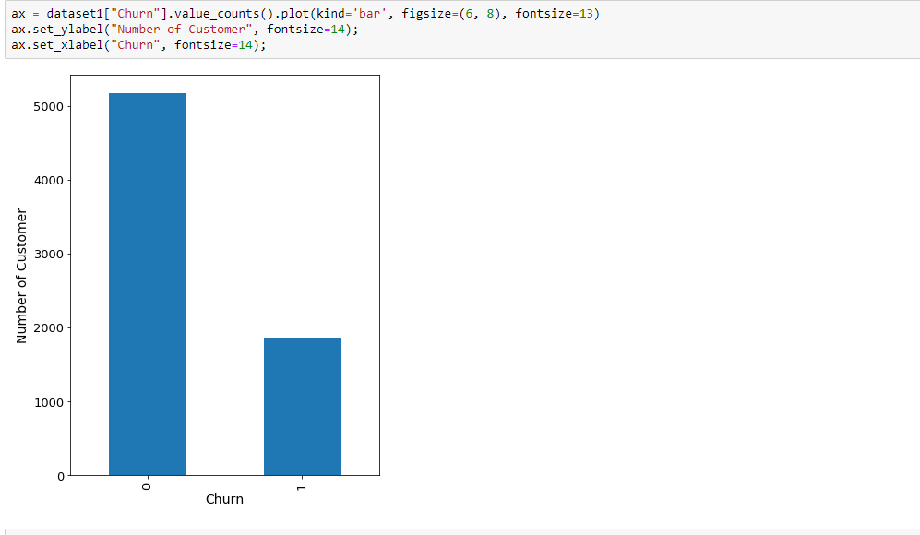
Bar Graph
1: ExitngUser
0: Not Exitng User
Plot Shows that the Users from the Data are likely to be Continuing their Subscription plan(>70%)

Slide 9
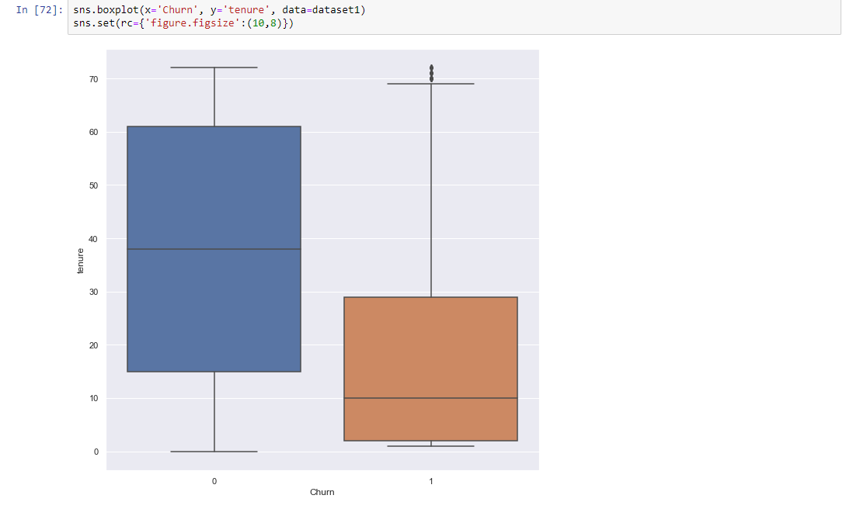
Box Plot
We found outliers in exiting customers which is out of whiskers. An Outlier is an observation that is numerically distant from the rest of the data.
Using Skew() method we found that Churn data is inconsistent with tenure
Customers who disconnecting their subscription plans are selecting short tenure Telecom Company need to offer better plans for those customers who choose short tenures.

Slide 10
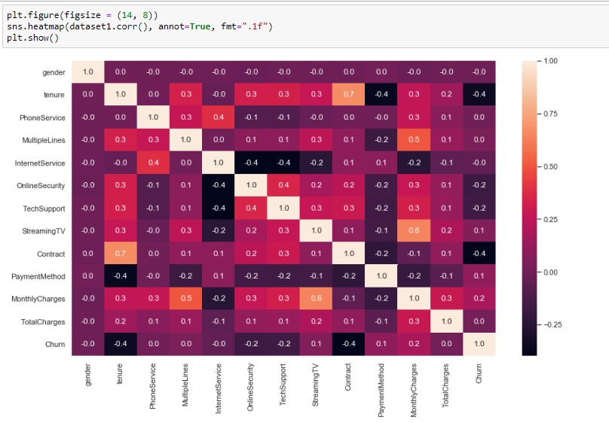
Heat map
Correlation: Dependence or association is any statistical relationship, whether causal or not, between two random variables or bivariate data. With the help of Correlation matrix, we can find interdependency between variables
1)Least dependency of variables for predicting churn are tenure and contract. 2)Churn variable is depending more on monthly charges.

Slide 11
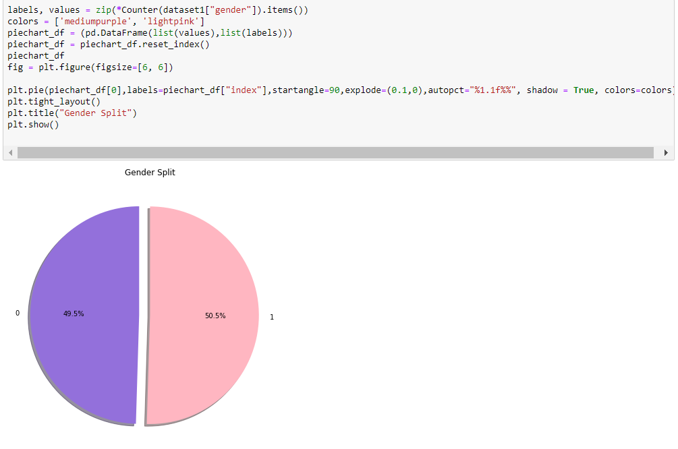
Pie Plot
1)Female subscribers are 49.5% of the total
2)Male subscribers are 55.5% of the total

Slide 12
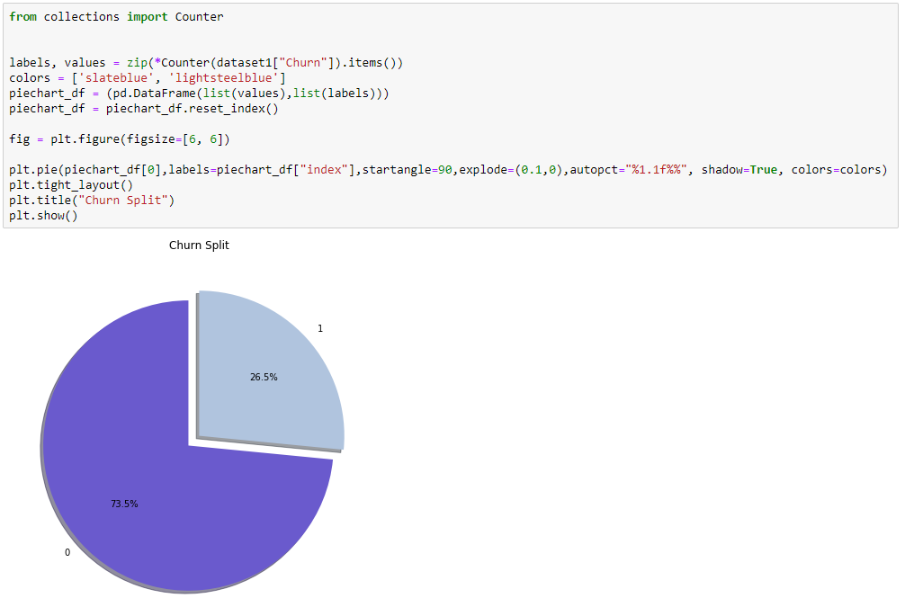
pIE plot
According to the collected data information 73.5% customers are continuing their subscription and 26.5% customers disconnected.

Slide 13
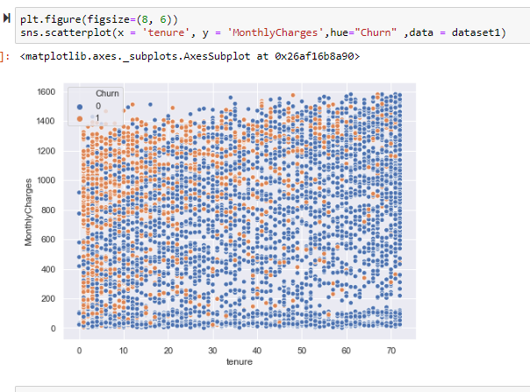
Scatter pLot
1)Customers paying high monthly charges for short tenures are disconnecting 2)Customers paying high monthly charges for long tenures continuing with their subscription plans, as it is reasonable cost

Slide 14
ACCURACY OF VARIOUS MODELS
MODELS | ACCURACY
KNN | 62%
SVM | 76%

Slide 15
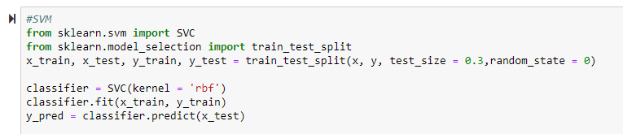
SVM MODEL

Slide 16
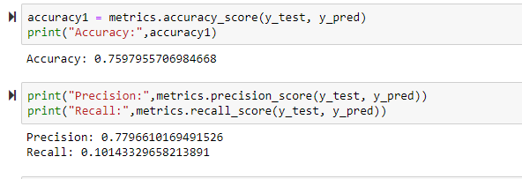

Slide 17
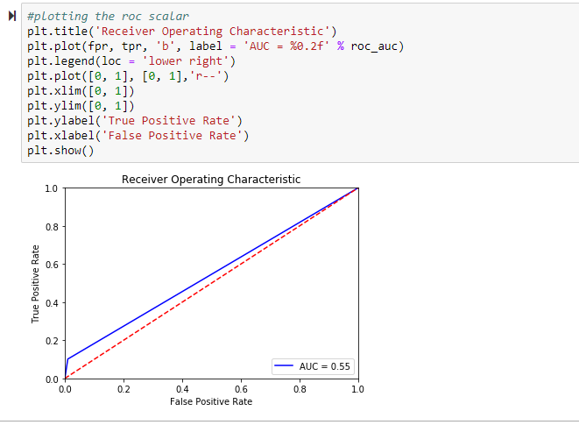

Slide 18
METRICS EVALUATION:
CONFUSION MATRIX:
ACCURACY: 76.12%
PRECISION : 77.96%
2589 | 26
815 | 92

Slide 19
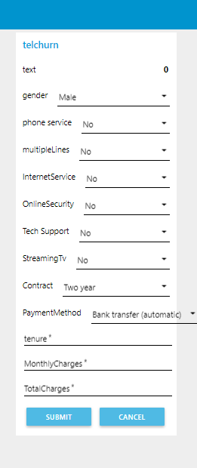
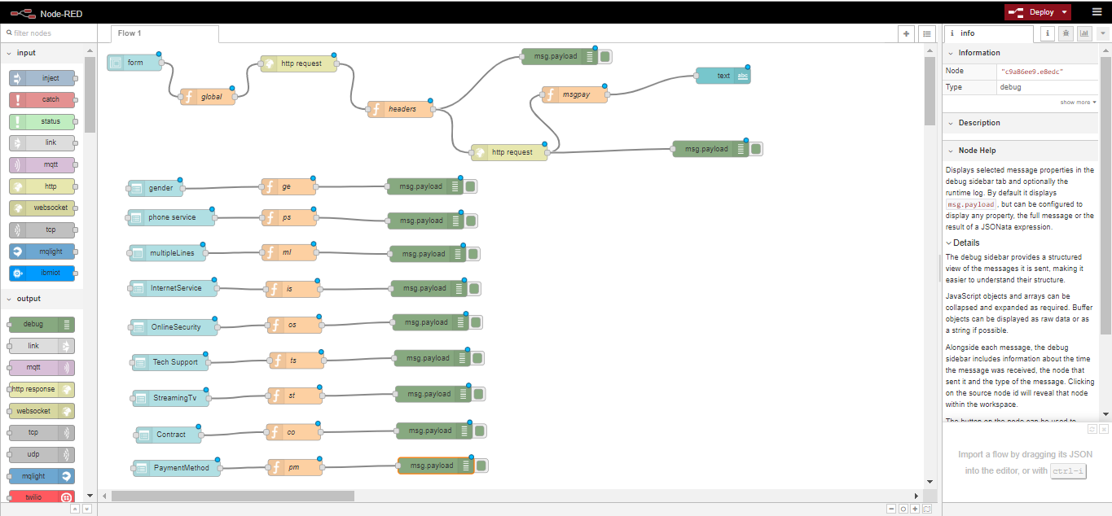
NODE Red(IBM wATSON STUDIO)
NODE RED FLOW WIRING
UI OF MODEL

Slide 20
FINDINGS AND SUGGESTIONS
Try to offer the better service for the churn customers ,see how much this impact before and later .Some may use your service better move them to your active customers.
Take the feedback and suggestions with in period of time and improve it ,strive for better communication.
When your are taking the any change in plans of your business just predict the positive and negative share of that plan. If it is negative prepare the solution before so You can handy easily.

Slide 21
How to Reduce Customer Churn
Lean into your best customers.
Be proactive with communication.
Define a roadmap for your new customers.
Offer incentives.
Ask for feedback often.
Analyze churn when it happens.
Stay competitive.

Slide 22
CONCLUSION
The importance of this type of research in the telecom market is to help companies make more profit.
It has become known that predicting churn is one of the most important sources of income to Telecom companies.
Hence, this research aimed to build a system that predicts the churn of customers i telecom company.
These prediction models need to achieve high AUC values. To test and train the model, the sample data is divided into 70% for training and 30% for testing.

